Slide 1
Book Cradle – Smart Library App
Borrow • Search • Admin Dashboard
Team: Ntombizikhona Qandashe, Indiphe Nondlanzi, Emmanual Januarie, Banzi Dube

Slide 2
Introduction
Goal: Simple & user‑friendly library system
Users search & borrow books
Admins track borrowed books
Data stored in library.txt (plain‑text storage)

Slide 3
Tech Stack
Java GUI (Swing / JavaFX)
Gradle for build & dependencies
CSS for modern styling
Storage: library.txt (flat file)

Slide 4

User Features
🔍 Search for books
📚 View available titles
📥 Borrow books
🧾 View personal borrow history

Slide 5

Admin Features
👁️ View all borrowed books
📋 Track borrower details
📊 Monitor inventory levels

Slide 6
Architecture Overview
Java GUI Layer – user/admin interface
Backend logic – book search, borrow, tracking
CSS – consistent, modern look
Gradle – project build & dependency mgmt

Slide 7

Testing
Manual feature testing
Edge cases – no books left, invalid input
System stability & performance checks

Slide 8
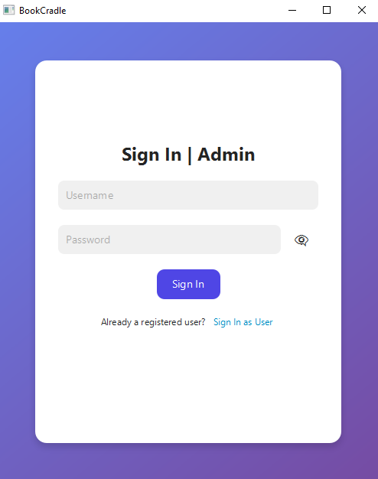
DEMO

Slide 9

Challenges & Solutions
Designing modern GUI → Used CSS & layouts
Data persistence → Implemented flat‑file storage
Syncing UI updates → Employed event listeners

Slide 10
Future Improvements
User & admin login system
Book return & due date reminders
Real‑time database sync
Analytics dashboard for usage stats

Slide 11

Conclusion
Functional library application delivered
Modern UI with Java & CSS
Scalable foundation for future features

Slide 12

Q & A
Thank you for listening!
Questions?

